Slide 1
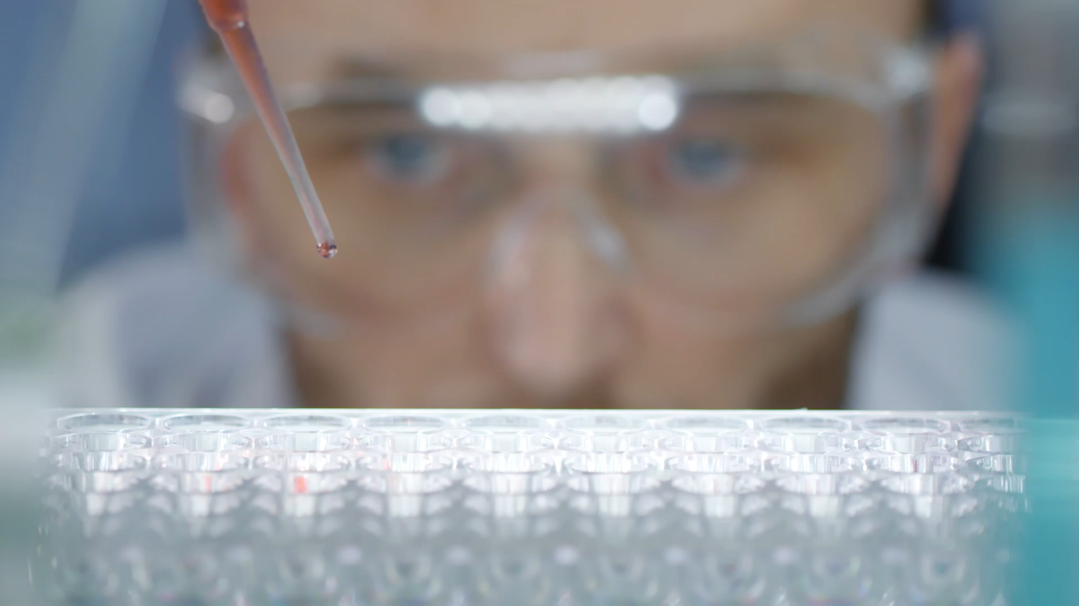
Predicting Total Cholesterol Level With Machine Learning
Anne Lösch

Slide 2
Background
Nearly 1 in 3 Americans have high cholesterol. ¹
According to the dataset used, over half of those with high cholesterol have never been told by a health professional they have high cholesterol.
High cholesterol is a major risk factor for heart disease, the leading cause of death of men and women in America. ^{2,3}

Slide 3
Question:
Can a machine learning model be used to estimate total cholesterol level from data provided by the user and technology such as health apps and fitness trackers?

Slide 4
Introduction:
What will be covered
Data I used to predict total cholesterol
Process to find the model
Best model
Limitations
Data needed to make a prediction

Slide 5
Table of Contents
Executive Summary
Data Exploration
Methodology/Process
Results
Limitations
Conclusion
Recommendations
References
Appendix

Slide 6

Executive Summary
Using NHANES survey data a Random Forest model was created that outperformed other models
This model can be used as a baseline for health apps to estimate total cholesterol

Slide 7
Data Exploration
Data for modeling came form the 2013-2016 National Health and Nutrition Examination Survey, a yearly survey conducted by the National Center for Health Statistics (CDC)
Datasets cover:
Demographics data
Dietary data
Examination data
Laboratory data
Questionnaire Data
Over 100 files and over 1500 variables are included in a year of NHANES Data
64 variables were read in and used for modeling
Target – Laboratory data, Cholesterol – Total, LBXTC - Total Cholesterol (mg/dL)

Slide 8
Methodology/Process
Data Cleaning
Filtering for age and fasting
Clean questionnaire data
Examine and handle missing values
Check for and handle invalid values
Engineer features including log transform y
Look for and handle outliers
EDA
Univariate Analysis
Bivariate analysis with total cholesterol
Multivariate analysis-examining correlation
Model Creation
Linear regression, K nearest neighbors, support vector regression, random forests, neural networks
Model Evaluation
Metrics
Graphs
Hypeparameter tuning and retraining of final model

Slide 9
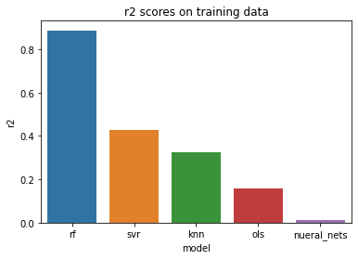
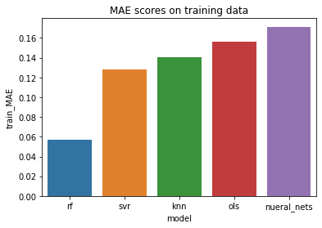
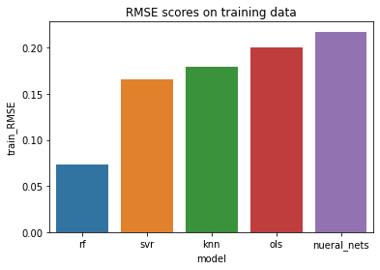
Results
Random forests performed best
R2 – 0.886
Testing mean absolute error -- 0.15
Testing root mean square error -- 0.19
Mean absolute error on non log-transformed data for random forests trained on full dataset – 22. Meaning: On average total cholesterol level may be off by 22 mg/dL

Slide 10
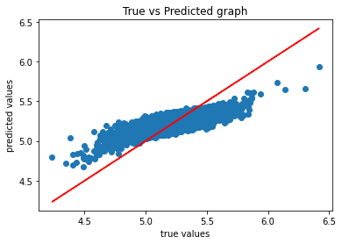
Limitations
16312
After filtering and cleaning data, only around 3500 observations were used for training out of around 16,000
Missing values needed to be imputed and so may not be accurate
As amount of physical activity was based on survey data, this may not be accurate
The final model struggles to predict extreme values.
Random forest will never predict outside the range of y values. (4.2,6.4)

Slide 11
Data Needed to Make Predictions
Demographic Data
Age
Gender
Race
Average daily total nutrient intake
Examination data
BMI
Blood pressure
Pulse
Is pulse irregular?
Physical Activity Data
Average daily minutes of vigorous activity multiplied by 8
Average daily minutes of moderate activity multiplied by 4
Substance use
Has the user used a tobacco product in the past 5 days
Average number of alcoholic drinks consumed per day
Chronic Conditions
Diabetes
Thyroid problems
Blood pressure and cholesterol problems

Slide 12
Conclusion
Question: Can we find a model to estimate total cholesterol level
Data
Modeling Process
Best Model: Random Forests
Limitations: Struggles to predict extreme values

Slide 13
Recommendations
Any health app that uses this model will need to retrain and hence ask users if they have had their cholesterol checked, and if so, what their total cholesterol level was.
To improve performance, average daily activity data could come from fitness trackers.
Further exploration is needed to see if information regarding chronic conditions can be left out.

Slide 14
References
Even if you're in your 20s you should get your cholesterol checked. Erin Blakemore. 2020. The Washington Post. https://www.washingtonpost.com/health/cholesterol-level-young-adults/2020/09/04/6a1f1f4c-ed81-11ea-b4bc-3a2098fc73d4_story.html
Cholesterol & Triglycerides Health Center. 2021. WebMD. https://www.webmd.com/cholesterol-management/default.htm
Cholesterol levels. 2020. Medline Plus. https://medlineplus.gov/lab-tests/cholesterol-levels/
Correlation and Regression with R. 2016. Boston University School of Public Health. https://sphweb.bumc.bu.edu/otlt/MPH-Modules/BS/R/R5_Correlation-Regression/R5_Correlation-Regression4.html
What Exactly Are METs, and What Should You Know About Them? Kristen Nunez. 2019. HealthLine. https://www.healthline.com/health/what-are-mets#:~:text=A%20MET%20is%20a%20ratio,expended%20per%20unit%20of%20time.&text=To%20put%20it%20in%20perspective,a%20MET%20value%20of%2012.3.

Slide 15
Appendix

Slide 16
Variables needed for prediction
RIDAGEYR -- the age of the person (years), integer
Systolic -- systolic blood pressure reading (mm Hg), float
Diastolic -- diastolic blood pressure reading (mm Hg), float
BMXBMI --- the body mass index of the individual (kg/m**2), float
BPXPLS -- the pulse of the individual, int
avg_daily_vigorous_activity -- minutes of average daily vigorous activity. Remember to multiply by 8, float
avg_daily_moderate_activity -- minutes of average daily moderate activity. Remember to multiply by 4, float
DR1TKCAL_t -- average daily caloric intake (kcal), float
DR1TPROT_t -- average daily protein intake (gm), float
DR1TCARB_t -- average daily carbohydrate intake (gm), float
DR1TSUGR_t -- average daily total sugar (gm), float
DR1TFIBE_t -- average daily dietary fiber intake (gm), float
DR1TTFAT_t -- average daily total fat intake (gm), float
DR1TSFAT_t -- average daily saturated fat intake (gm), float
DR1TMFAT_t -- average daily monounsaturated fatty acids intake (gm), float
DR1TPFAT_t -- average daily polyunsaturated fatty acids (gm), float
DR1TCHOL_t -- average daily intake of Cholesterol (mg), float
DR1TSODI_t -- average daily intake of Sodium Sodium (mg), float
DR1TVD_t -- average daily intake of Vitamin D (D2 + D3) (mcg), float
DR1TCALC_t -- average daily intake of Calcium (mg), float
DR1TIRON_t -- average daily intake of Iron (mg), float
DR1TPOTA_t -- average daily intake of Potassium (mg), float
avgALC -- average number of alcoholic drinks per day, float
RIAGENDR -- the gender of the individual, 0 -- female, 1 -- male
RIDRETH3 -- race, 1 --Mexican American, 2 -- Other Hispanic, 3 -- Non-Hispanic White, 4 -- Non-Hispanic Black, 6 -- Non-Hispanic Asian, 7 -- other race including multi-racial
BPXPULS -- pulse type, 0 -- regular, 1 -- irregular
BPQ020 -- Ever told you had high blood pressure, 0 -- no, 1 -- yes
BPQ050A -- Now taking prescription medication for high blood pressure, 0 -- no, 1 -- yes
BPQ080 -- Ever told you have high cholesterol, 0 -- no, 1 -- yes
BPQ100D -- Now taking prescription medication for high cholesterol, 0 -- no, 1 -- yes
DIQ010 -- Doctor told you that you have diabetes, 0 -- no, 1 -- borderline, 2 -- yes
MCQ170M -- Do you still have thyroid problems, 0 -- no, 1 -- yes
SMQ681 -- smoked tobacco in the last 5 days, 0 -- no, 1 -- yes

Slide 17

Random Forest Pipeline
Scale with MinMaxScaler
1
Log transformed skewed numerical variables
2
Impute missing variables using:
3
KNN Imputer for numerical variables
SimpleImputer using most frequent for categorical variables
Use Random Forest Regressor
4
Hyperparameters – all default except for
max_depth: 10
max_features: 10
n_estimators: 200

Slide 18
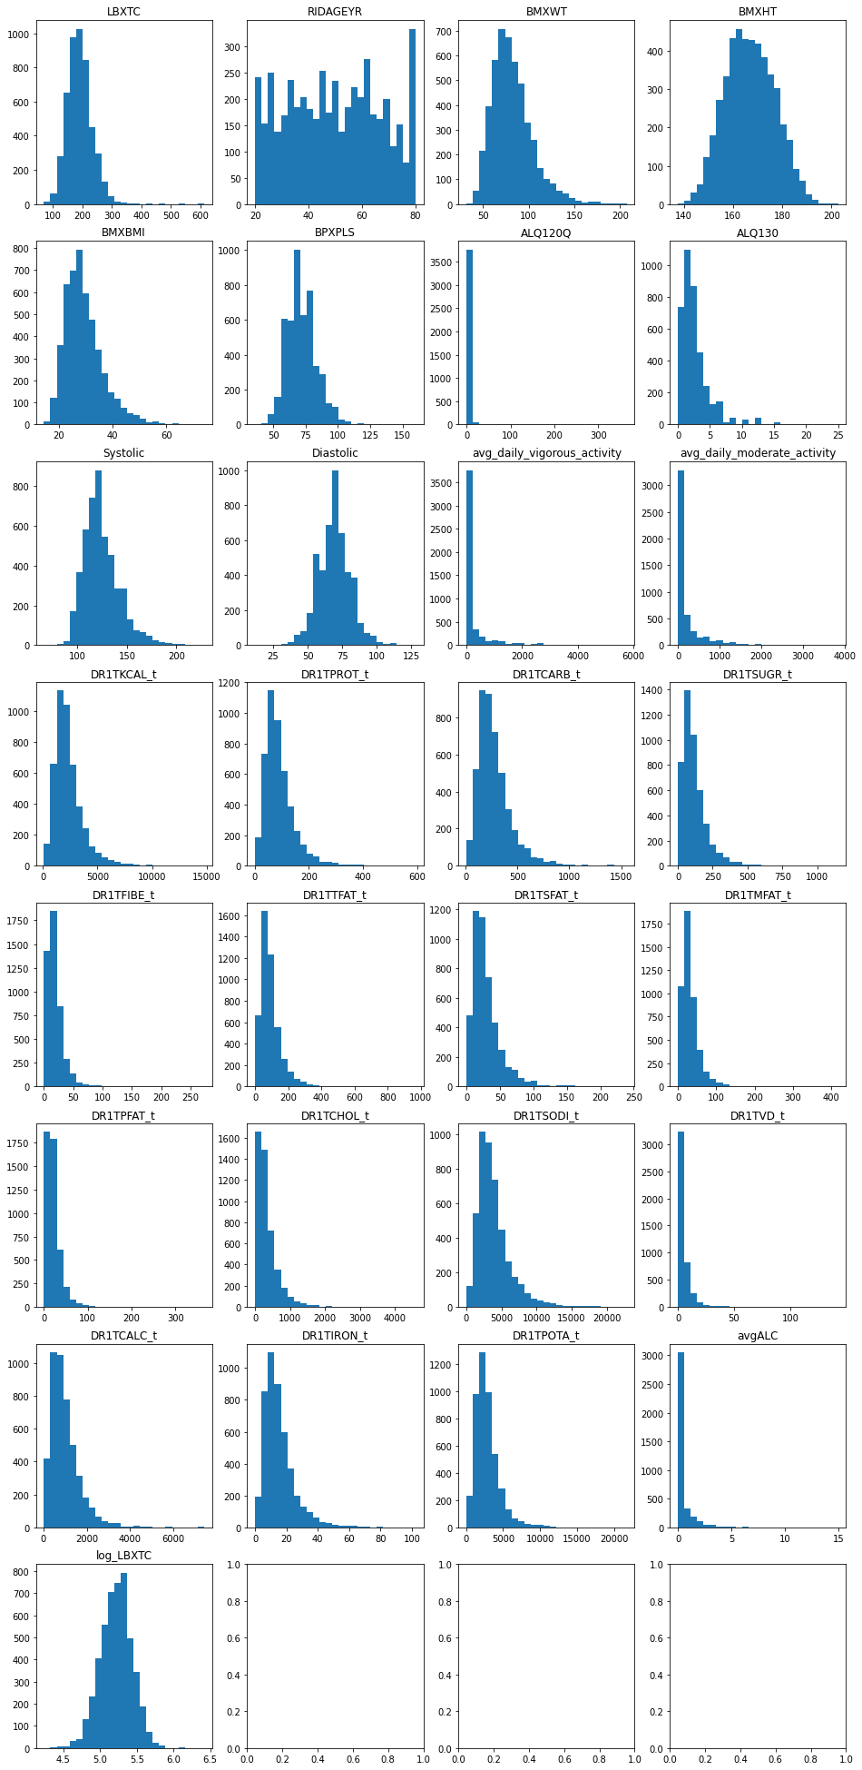
Log Transformation of Skewed Variables
Many numerical variables had skewed distributions
During the EDA I used machine learning to see if, all else held constant, the model performed better with or without log transforming the variables.
Results: log transformation was better.

Slide 19
Transforming Physical Activity Data
Codebook on physical activity questionnaire gave suggested MET scores of 8 for vigorous activity and 4 for moderate activity
MET is a way to describe the intensity of the exercise. ⁵

Slide 20
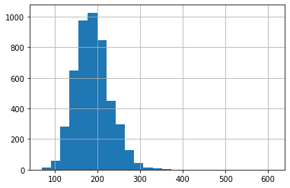
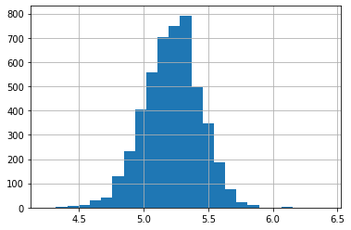
Why log transform y?
Linear Regression assumes normaliity⁵

Slide 21
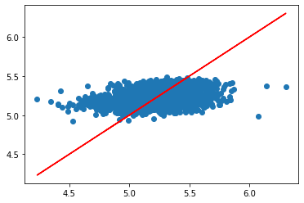
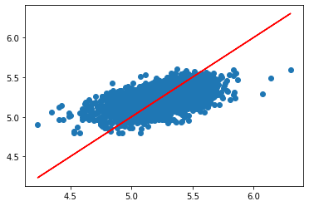
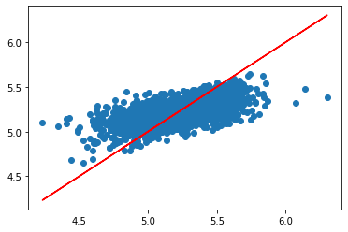
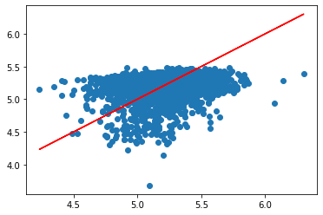
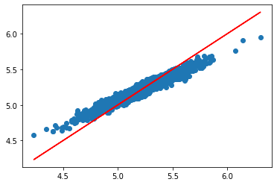
Models trained
Linear Regression
K Nearest Neighbors
Support Vector Regression
Neural Network
Random Forests

Slide 22

Types of Cholesterol
3 Type of Cholesterol ⁴
LDL, “bad” cholesterol
HDL, “good” cholesterol
Total Cholesterol

Slide 23
Why regression and not classification?
Better to know how high total cholesterol might be

Slide 24
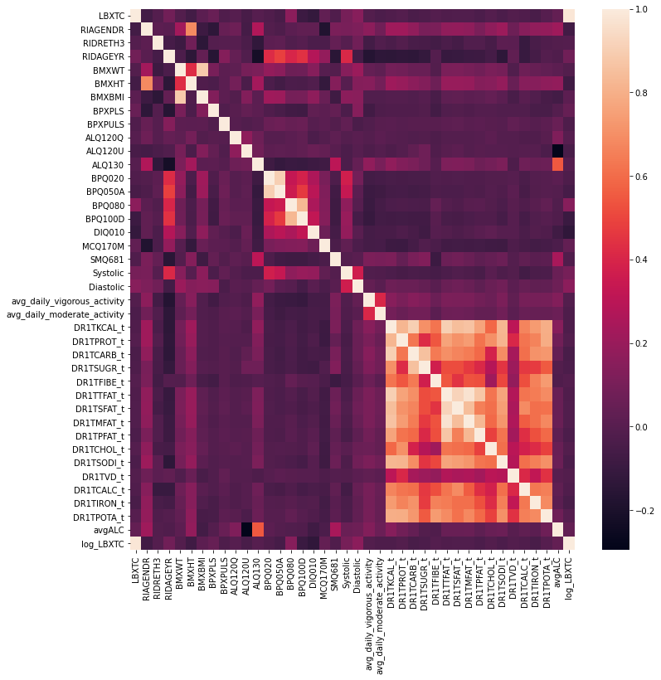
Unsupervised Learning Methodologies Used
DBSCAN was used during outlier detection
As there was some higher correlation between variables, PCA was used with linear regression, SVR, and neural networks.

Slide 25
Links
National Health and Nutrition Examination Survey: https://www.cdc.gov/nchs/nhanes/index.htm
Statistics by Jim article on R2: https://statisticsbyjim.com/regression/r-squared-invalid-nonlinear-regression/
Project on Github: https://github.com/mathisme/ThinkfulDSFinalCapstone
LinkedIn: https://www.linkedin.com/in/annelosch/

